Slide 1
Visualization Ethics
Week 6
Notes:
https://www.analyticodigital.com/blog/ethics-of-data-visualization-avoiding-deceptive-practices#:~:text=Ethical%20considerations%20in%20data%20visualization,%2C%20impacting%20decision%2Dmaking%20processes.

Slide 2
Principles

Slide 3
Principles
Accuracy and Honesty
Clarity and Simplicity
Fairness and Objectivity
Privacy and Trust:
Inclusiveness and Accessibility:

Slide 4
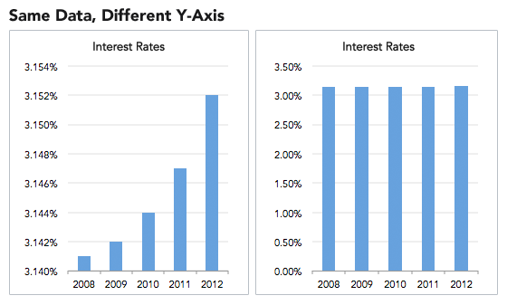
Accuracy and Honesty:
Accurate and honest data visualizations build trust by providing a reliable representation of information. This helps make informed decisions based on factual data, rather than distorted or manipulated visuals.
Notes:
Example: Misleading visualizations can erode public trust in data. Like, a graph showing exaggerated growth may mislead stakeholders about the actual performance of a project.

Slide 5
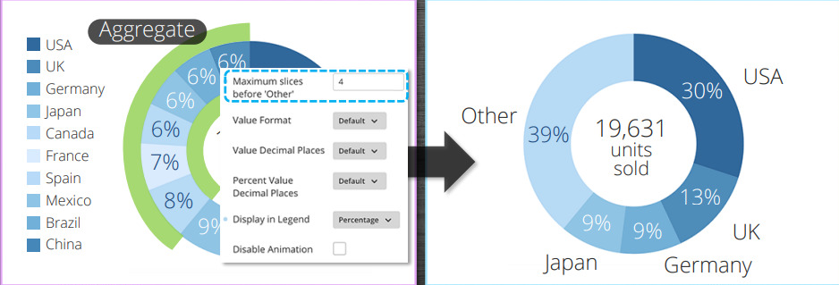
Clarity and Simplicity
Clear and simple visualizations enhance understanding, making complex data more accessible to a broader audience. Balancing aesthetics with functionality ensures that the message is easily comprehensible without unnecessary complexity.
Notes:
Example: A clutter-free chart design can help executives quickly grasp key insights from a quarterly financial report, leading to more effective decision-making

Slide 6
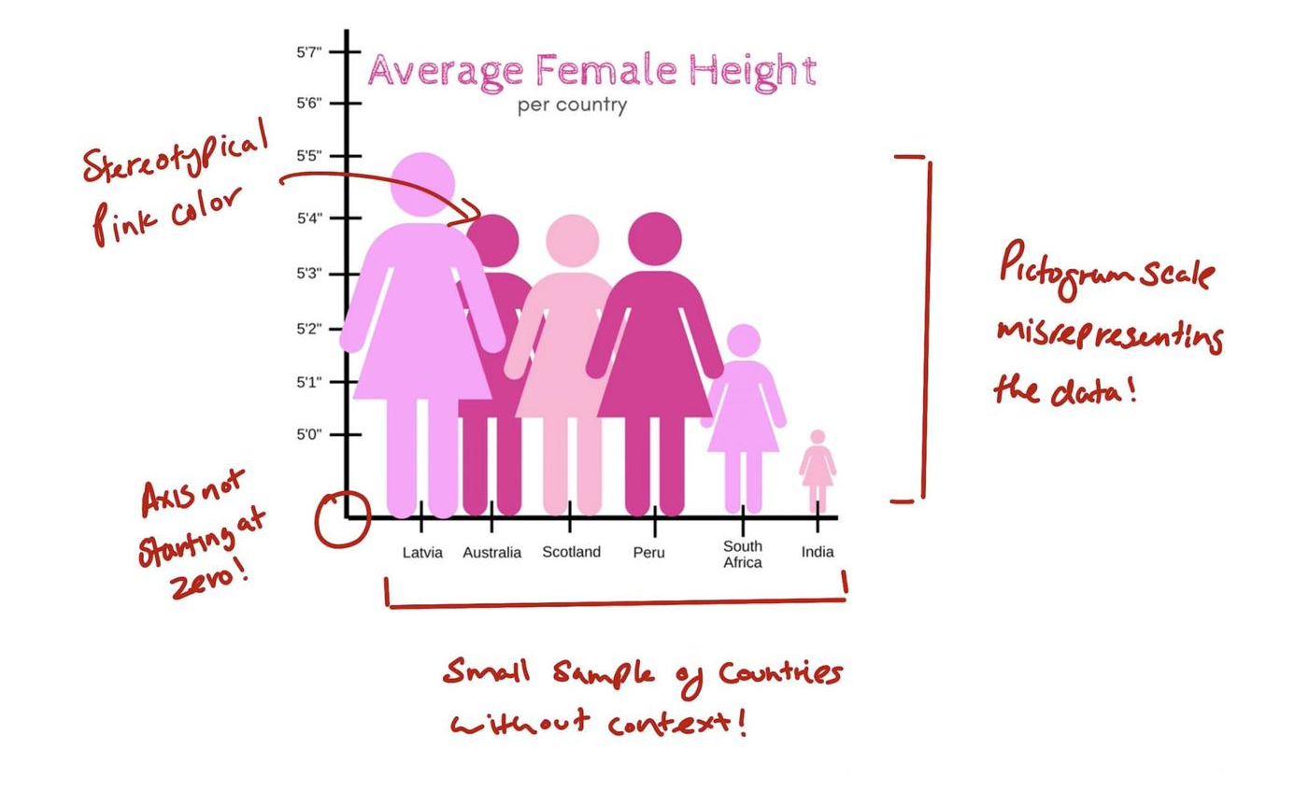
Fairness and Objectivity
Striving for objectivity in data presentation fosters fairness and prevents the introduction of personal bias or stereotypes. Transparent communication about data sources and methodology promotes credibility and fair interpretation.
Notes:
Example: Presenting demographic data without skewing representations ensures a fair and unbiased understanding of population trends, fostering equitable decision-making.

Slide 7
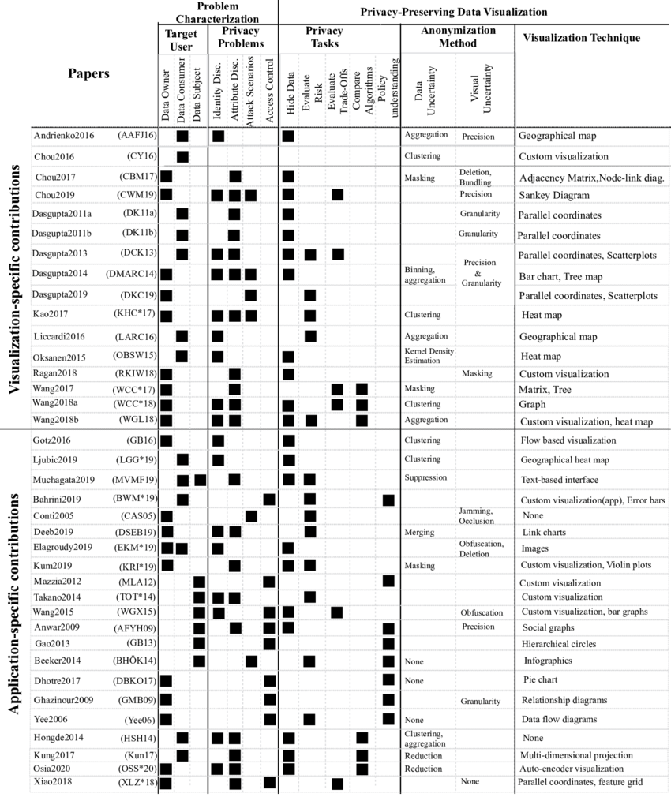
Privacy and Trust
Respecting privacy is critical in data visualization. Adhering to relevant laws and ethical guidelines protects sensitive information, preserving the trust of individuals and organizations.
Notes:
Example: When visualizing healthcare data, it's crucial to keep hidden patient information to protect privacy and comply with healthcare regulations, fostering trust in the healthcare system.

Slide 8
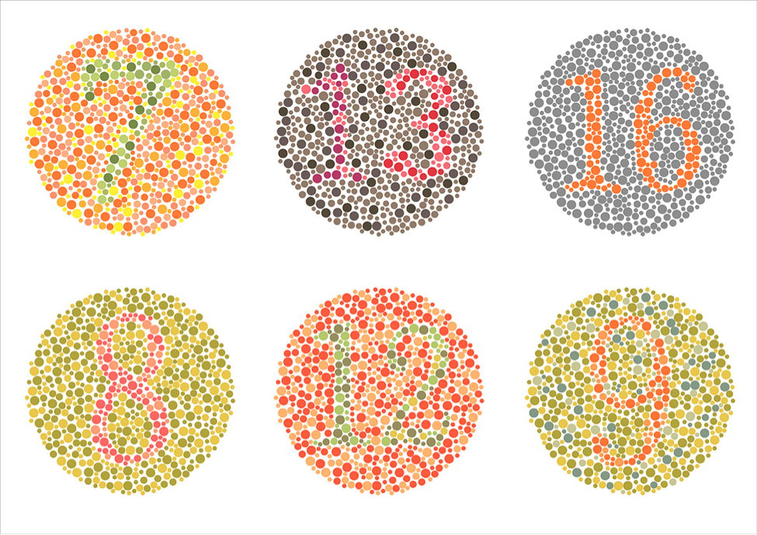
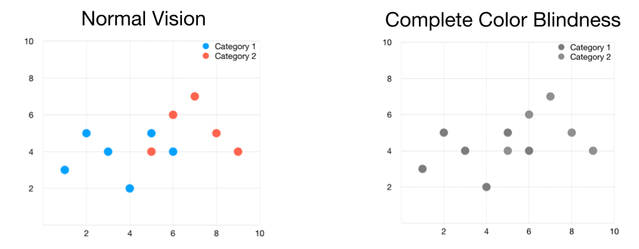
Inclusiveness and Accessibility
Ensuring that visualizations are inclusive and accessible to diverse audiences is an ethical imperative. Considering factors like color readability for those with visual impairments and cultural sensitivities enhances accessibility.
Notes:
Example: Creating data visualizations with high contrast and providing alternative text descriptions ensures that individuals with visual impairments can access and understand the information, promoting inclusivity.

Slide 9
Pitfalls

Slide 10
Pitfalls
Misleading Scaling
Cherry-Picking Data
Inaccurate Visual Representations
Ambiguous Labels and Legends
Out-of-Context Data
Biased Color Usage
Overemphasis on Outliers
Failure to Update
Lack of Accessibility
Failure to Explain Methodology

Slide 11
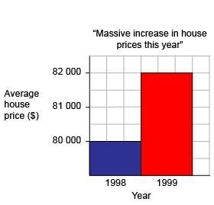
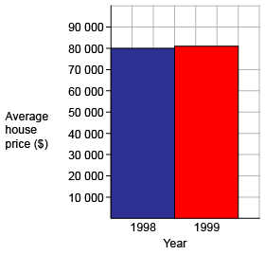
Misleading Scaling
Adjusting axes or scales improperly can exaggerate or minimize differences in data. Always use consistent and appropriate scales to avoid distorting the visual representation.

Slide 12
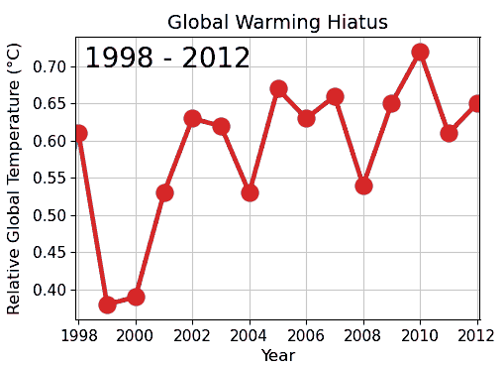
Cherry-Picking Data
Selectively choosing data points to support a specific narrative is unethical. Present the entire dataset or clearly state the criteria for data selection.

Slide 13
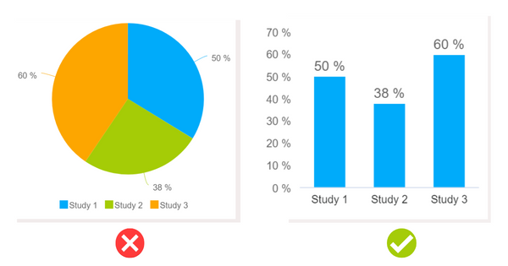
Inaccurate Visual Representations
Avoid using misleading visual elements, such as 3D charts, truncated axes, or inappropriate chart types. Choose visualizations that accurately represent the data without introducing unnecessary complexity.

Slide 14
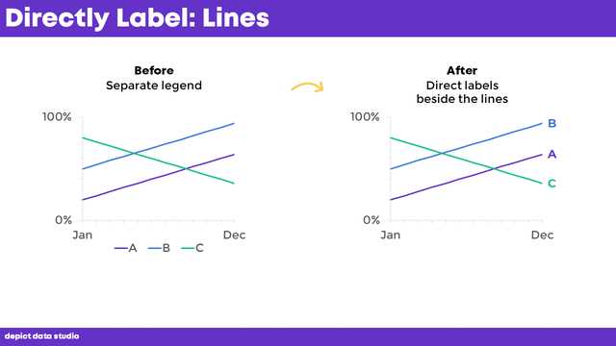
Ambiguous Labels and Legends
Clearly label all axes, data points, and legends to prevent confusion. Ambiguous or misleading labels can lead to misinterpretations.

Slide 15
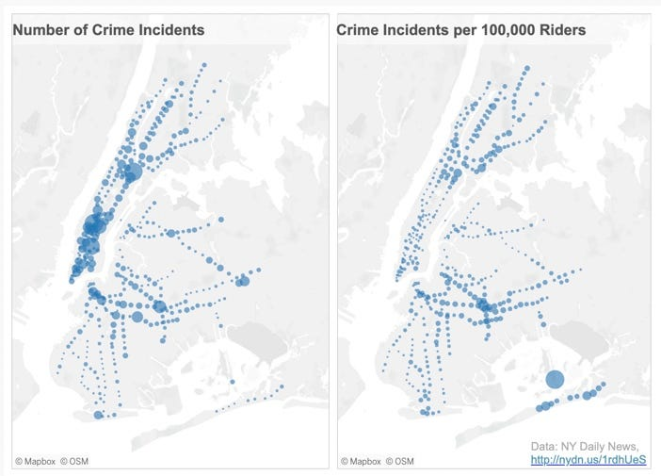
Out-of-Context Data
Present data within its relevant context. Failing to provide context can lead to misinterpretations and incorrect assumptions.

Slide 16
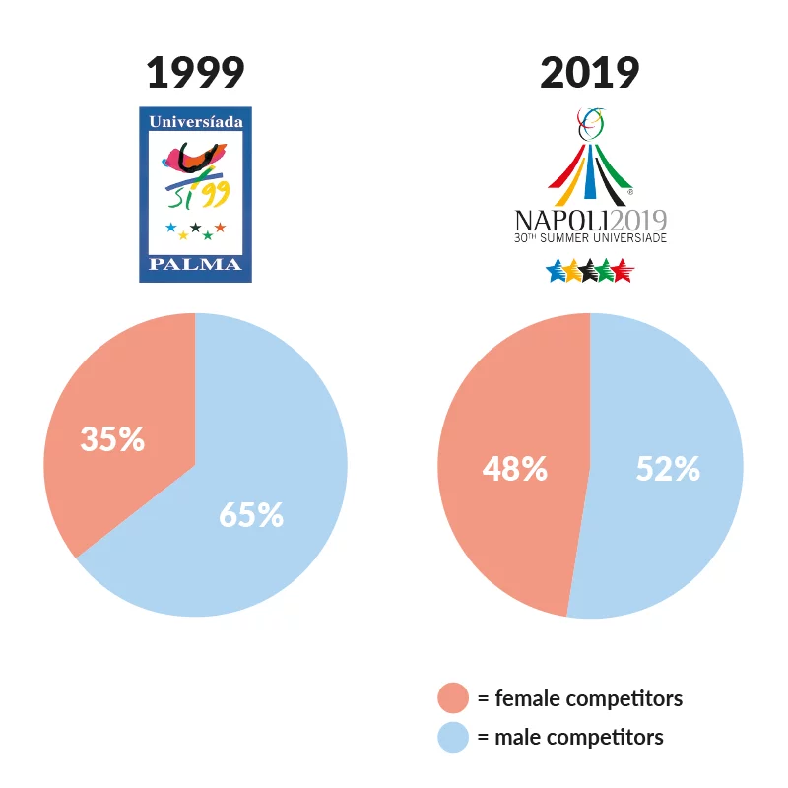
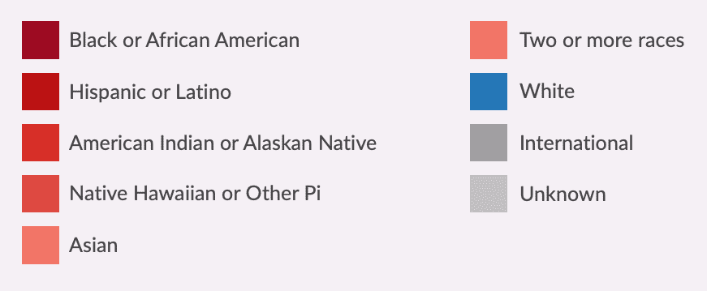
Biased Color Usage
Carefully choose colors in a way that doesn't imply false associations or biases. Be mindful of cultural connotations and ensure color choices are accessible to all viewers.
Notes:
According to a 2020 article published in the Journal of Experimental Psychology, English-speaking participants commonly associate the color red with concepts related to aggression, attraction, or heightened attention (e.g., stop, danger), while darker colors often have negative connotations. Consequently, using these colors to represent people can be problematic, as they may imply danger or negativity. See also “Avoid associating “black” or darkness with bad, and “white” or lightness with good.”
Another consideration is avoiding colors that perpetuate stereotypes. For example, the Urban Institute’s Do No Harm Guide: Applying Equity Awareness in Data Visualization recommends against using pink for women and blue for men—a combination that could reinforce thinking of gender as a binary construct—as well as matching colors to skin tones (like using black to represent Black people).

Slide 17
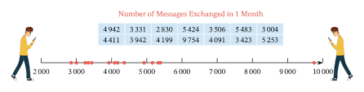
Overemphasis on Outliers
Highlighting outliers without context can skew perceptions. Communicate the significance and relevance of outliers to avoid misinterpretations.

Slide 18
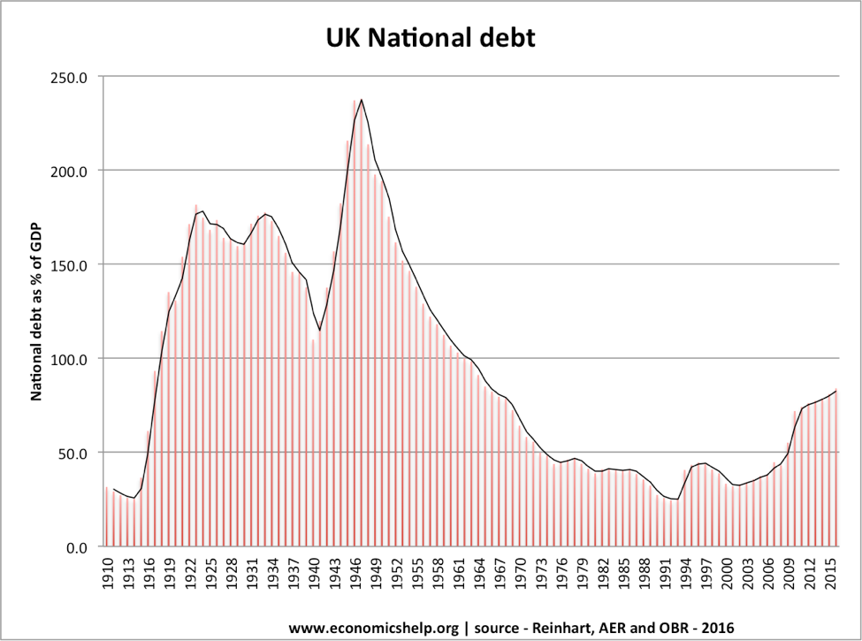
Failure to Update
Regularly update visualizations to reflect the most recent and relevant data as we all know trends change rapidly so adding new data is the demand. Outdated information can lead to inaccurate conclusions.

Slide 19
Lack of Accessibility
Ensure that visualizations are accessible to all users, including those with disabilities. Provide alternative text for images, use color contrasts, and choose readable fonts.

Slide 20

Failure to Explain Methodology
Communicate the methods used to collect, analyze, and visualize data. Lack of transparency in methodology can raise doubts about the reliability of the information.

Slide 21


